Slide 1
Advanced Television Receivers
Co-Troubleshoot color TV receivers

Slide 2
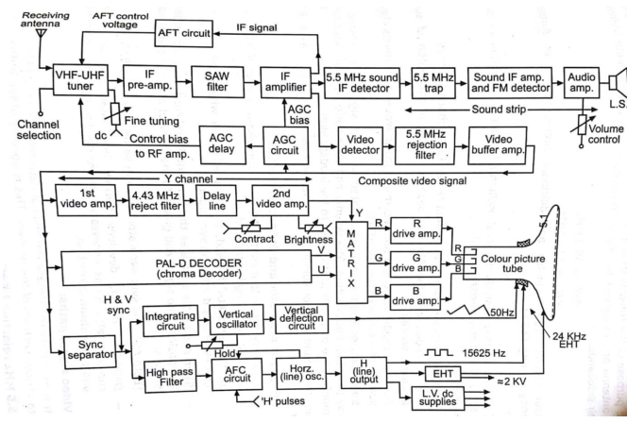
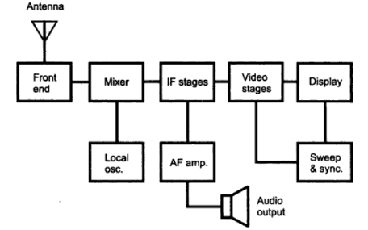
PAL color TV receiver

Slide 3
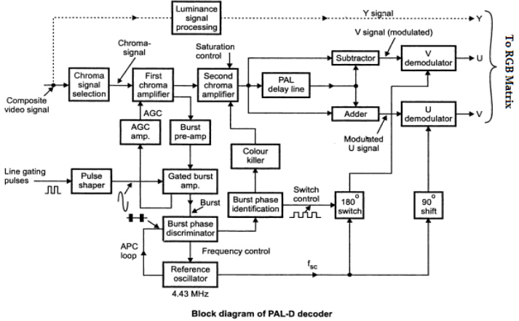

Slide 4
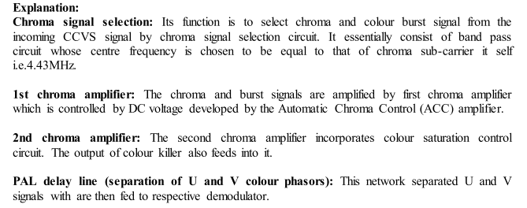
Pal d

Slide 5
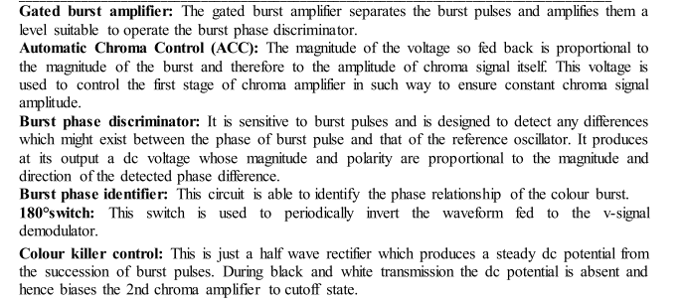

Slide 6
HDTV
High-definition television (HDTV) is a digital television, broadcasting system with greater resolution and wider screen ,than traditional television systems (NTSC, SECAM, PAL).
requires less bandwidth if sufficient video compression is used.
ability to support multi-channel audio such as Dolby Digital.
HDTV uses a ratio of 16:9. This wider aspect ratio 16:9 widescreen
HDTV signal supports up to 1080. The three formats used by HDTV are 1080i (interlaced), and 720p and 1080p (progressive).
HDTV also provides a higher-quality digital audio
MUSE ( Multiple sub nyquist sampling encoding) developed by NHK( Nippon Hoso Kyokai) hdtv broadcaster in Japan translate program .BW compression tech,

Slide 7
Aspect ratio - Standard television has a 4:3 aspect ratio -- it is four units wide by three units high. HDTV has a 16:9 aspect ratio, more like a movie screen.
Resolution - The lowest standard resolution (SDTV) will be about the same as analog TV and will go up to 704 x 480 pixels. The highest HDTV resolution is 1920 x 1080 pixels. HDTV can display about ten times as many pixels as an analog TV set.
Frame rate - A set's frame rate describes how many times it creates a complete picture on the screen every second. DTV frame rates usually end in "i" or "p" to denote whether they are interlaced or progressive. DTV frame rates range from 24p (24 frames per second, progressive) to 60p (60 frames per second, progressive).

Slide 8
HDTV requires three parts:
A source, such as a local, cable or satellite HDTV station
A way to receive the signal, like an antenna, cable or satellite service
An HDTV set
Many HDTVs have High-Definition Multimedia Interface (HDMI) connections, which can transmit audio/visual signals to the TV without compression

Slide 9
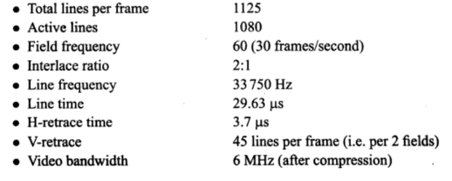
HDTV Standards

Slide 10
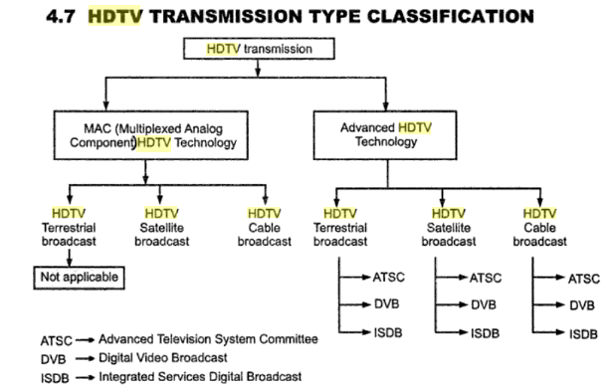

Slide 11
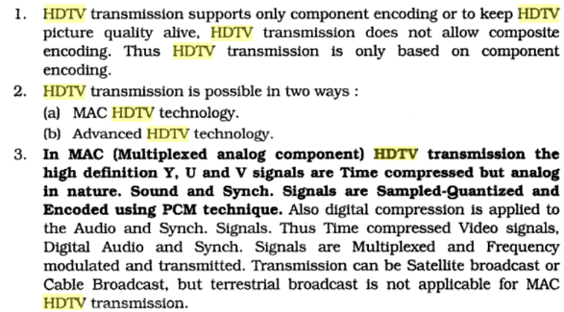

Slide 12
MAC( Multiplexed analogue component)
MAC was a satellite tv standard for HDTV
A digital + analog system use only for satellite Tv broadcaster
There r 5verstion – AMAC,BMAC,CMAC,DMAC,D2MAC

Slide 13
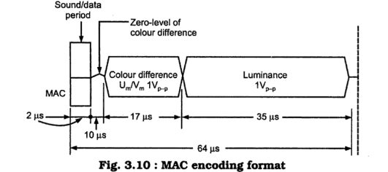
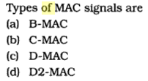
Advantages 1. MAC system uses the separation of luminance & choma signal
So cross modulation eliminated, fully band width utilize .
2. Encryption is possible for pay channel.
3. MAC signal is used in DTH/ direct reception of satellite program.
4.It maintain high quality of picture
5. It can provides multiple sound channel .through usb, microphone
6.MAC system process produces 625 lines on each scan so high definition
Picture can display.

Slide 14
Digital television (DTV)
1.Digital television is transmission and reception of moving video image in digital form.
2.D T system in which analog audio and video signals are converted into digital pulse form for transmission after detection at receiver are reconverted into analog signals for reproduces original sound and picture is called DTV.
Why need this ------
Picture quality – high
Noise reduces –cross color effect less
Ghost image reduces
Flicker removed

Slide 15
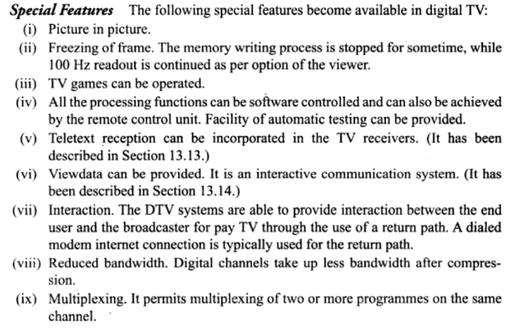

Slide 16
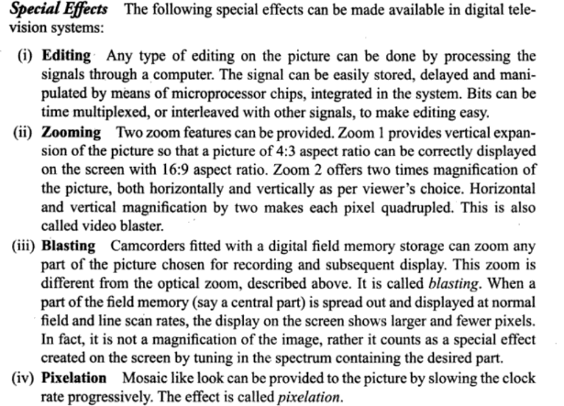

Slide 17
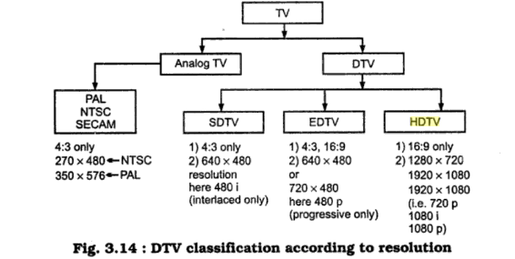

Slide 18
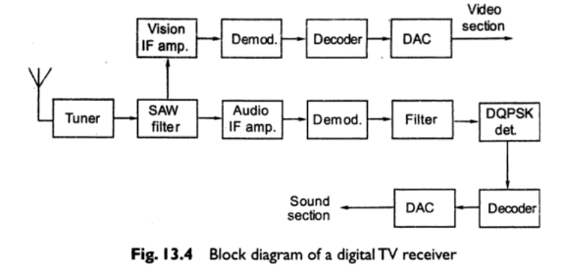
Tuner select desire channel
Sharp filter –separate Audio IF and Video IF
Video bits are detected and decoded to give original
Samples after decompression.
These are converted in to analog using DAC
For Audio –IF converted into intercarrier frequency
Sampled audio pulses are obtained by using DQPSK
Demodulated pules pass through decoder and DAC
To get original sound

Slide 19
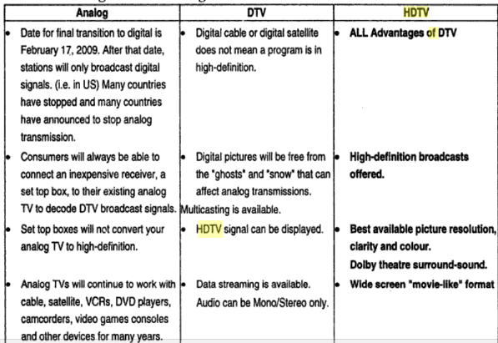

Slide 20
Colour picture display devise include CRT , FLAT PANNEL DISPLAY LIKE LCD , LED , PLASMA ,
LCD TV –Larger area, flat screen , colour tv

